Slide 1

Expert System
Definition
Advantage & Disadvantage
Expert System Architecture
Forward Chaining Inference Engine

Slide 2

Rule Base System => Expert System
Expert System:
  A computer program designed to model the problem-solving ability of a human expert [Durkin]
  A computer system that emulates the decision-making ability of a human expert in a restricted domain [Giarratano & Riley]
  A computer program that represents and reasons with knowledge of some specialist subject with a view to solving problems or giving advice. [Jackson]
  An intelligent computer program that uses knowledge and inference procedures to solve problems that are difficult enough to require significant human expertise for their solutions. [Edward Feigenbaum]

Slide 3
Where the expert system can be build?
The knowledge engineering field will have an impact on all areas of human activity where knowledge provides the power for solving important problems [Frederick Hayes – Roth]
Major Application Areas of Expert Systems
- Agriculture - Law - Business
- Manufacturing - Chemistry - Mathematic
- Communications - Medicine - Computer Systems
- Meteorology - Education - Military
- Mining - Electronics - Engineering
- Power Systems - Environment - Science
- Geology - Space Tech. - Image Processing
- Transportation - Information Management - Etc.

Slide 4
Advantage & Disadvantage
Advantages of Expert Systems
  Company less reliant on the expert.
  Expertise can be increased by copying the program.
  Expertise can be made available in otherwise inaccessible situations.
  Experts can continue with ‘more difficult’ tasks.
  Decisions become more predictable and consistent.
  Development process leads to better understanding of the problem.
  Less qualified staff can perform at expert level!
Disadvantages of Expert Systems
  The expertise may be difficult to define.
  Expert systems are reliable only within strictly defined domains.
  The technology is expensive.
  Development is time consuming
  Expert systems threaten professionals.
  Eventual reliance on Technology.

Slide 5

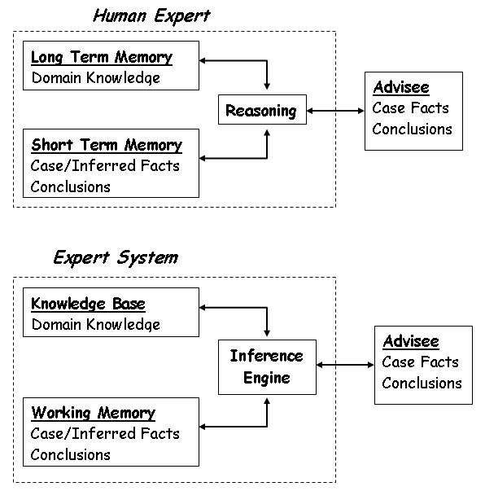

Human Expert & Expert System Structure

Slide 6
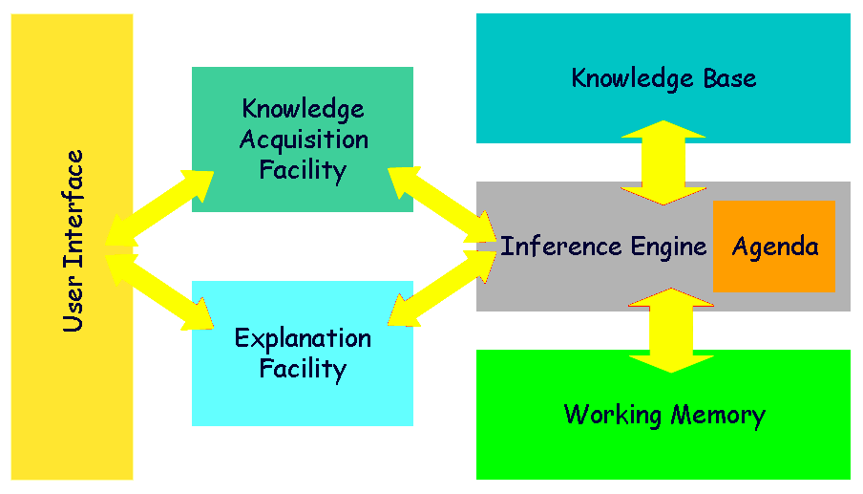
Expert System Architecture

Slide 7
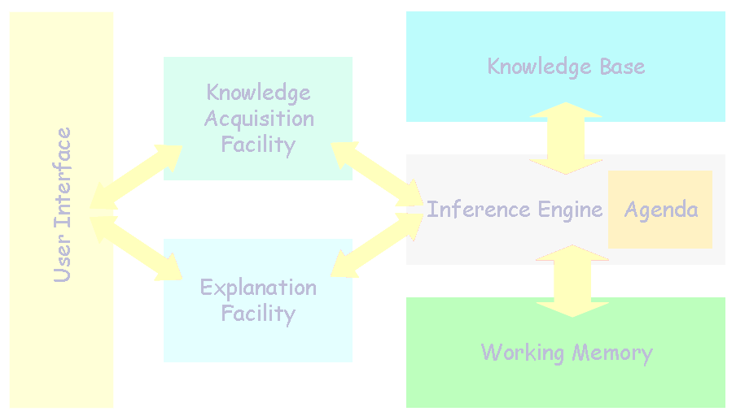
Knowledge Base
Part of an Expert System that contain Domain Knowledge.
Rules as representation mechanism.
A rule is an IF / THEN structure that logically relates information in the IF part (premise) to other information in THEN part (conclusion).
Examples:
Rule 1
IF The car will not start
THEN The problem may be in the electrical system
Rule 2
IF The problem may be in the electrical system
AND The Battery Voltage is below 10 volts
THEN The fault is a bad battery

Slide 8


Knowledge Acquisition Facility
Knowledge
Result
Expert System
Domain
Experts
Knowledge
Engineer
Knowledge Engineering Paradox:
The more competent domain experts become, the less able they are to describe the knowledge they used to solve problems! [Waterman]

Slide 9
Working Memory
Part of Expert Systems that contains the problem facts that are discovered during the session.
The Working Memory contains all the information about the problem that is either supplied by the user or inferred by the system.
The entire information gained during the consultation is called the session’s context.
Many Expert System applications can use information contain in External Storage as databases, spreadsheets or sensors.

Slide 10
Inference Engine
Processor in an Expert System that matches The Facts in The Working Memory with The Domain Knowledge in The Knowledge Base, to draw conclusions about problem.
It searches the rules for a match between their premise and information contained in The Working Memory.
When the inference engine finds a match, it add rule’s conclusion to The Working Memory and continues to scan the rules for new matches.

Slide 11
Inference Engine
Rule 1 Rule 2
IF The car will not start IF The problem may be in the electrical system
THEN The problem may be in AND The Battery Voltage is below 10 volts
the electrical system THEN The fault is a bad battery
Illustration:
Expert System : Does the car not start?
User : True
User assert this fact to Working Memory. Since this fact support RULE 1, Expert System assert the rule’s conclusion to The Working Memory.
Expert System : Is the battery voltage below 10 volts?
User : True
The Working Memory now contains the facts that support RULE 2 and Expert System assert the rule’s conclusion to The Working Memory.
The Session stops because there are no further rules to consider. Expert System give the advise to the User.
Expert System (Result) : The fault is a bad battery.

Slide 12
Explanation Facility
A trademark of Expert Systems is their ability to explain their reasoning.
They have a module called Explanation Facility so that they can provide an explanation to the user about Why they asking their question and How they reach some conclusion.

Slide 13
Explaining WHY
Human Expert – Advisee
Expert : Will the car not start?
Advisee : Why do you ask it?
Expert : If I know that car won’t start, then I usually assume the problem is in the electrical system.
Expert System – User
Expert System : Does the car not start?
User : WHY
Expert System : IF The car will not start THEN The problem may be in the electrical system

Slide 14
Explaining HOW
Human Expert - Advisee
Expert : The battery is bad.
Advisee : How do you get that answer?
Expert : Since your car won’t start, I assumed there was a problem with the electrical system. Once I found the battery voltage was below 10 volt, I knew the battery was bad.
Expert System – User
Expert System : The fault is a bad battery
User : HOW
Expert System : - The car will not start
- The problem may be in the electrical system
- The Battery Voltage is below 10 volts
- The fault is a bad battery

Slide 15
Interface
Interaction between an expert system and user is conducted in a natural language style.
Must be highly interactive and follows closely the conversation found between humans.
Basic design requirement of the interface is to ask questions.
Particular attention to the question’s design is required to obtain reliable information from the users.
May require The Expert System Designer to design the interface using menus, graphics or etc.

Slide 16

Inference Engine Types
Forward Chaining (Data - driven Search)
  Begins with a set of known facts
  Derives new facts using rules whose premises (if side) match the known facts,
  Continues this process until a goal state is reached or until no further rules have premises that match the known or derived facts
Backward Chaining (Goal – driven Search)
  Inference strategy that attempts to prove a hypothesis by gathering supporting information.

Slide 17
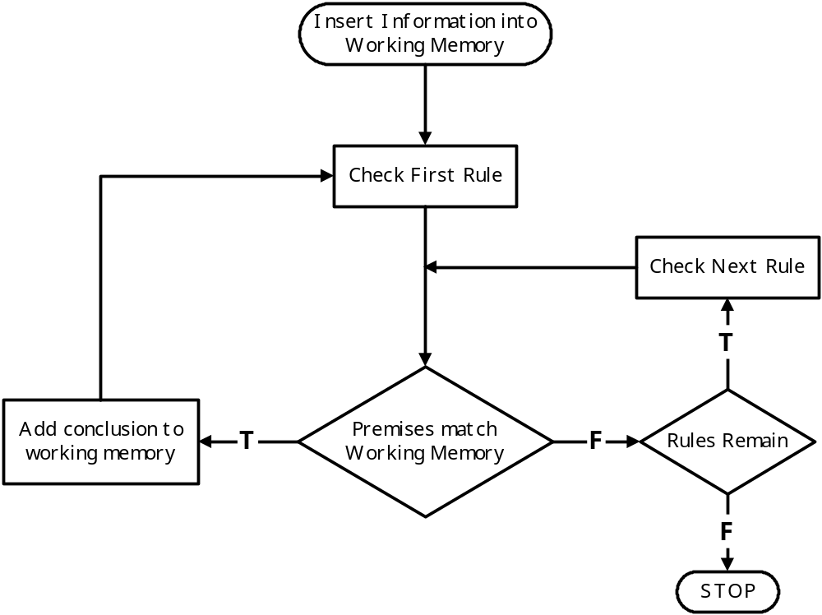
Forward Chaining

Slide 18

Forward Chaining
Example: Diagnosing Strep Throat
Rules:
Rule 1: IF the patient has a sore throat
AND we suspect a bacterial infection
THEN we believe the patient has strep throat
Rule 2: IF the patient’s temperature is > 100º F
THEN the patient has a fever
Rule 3: IF the patient has been sick over a month
AND the patient has a fever
THEN we suspect a bacterial infection
All facts from the patient that is asserted in Working Memory:
- Patient’s temperature = 102º F
- Patient has been sick for two months
- Patient has a Sore Throat

